Slide 1
Bulletproof Transient Error Handling with Polly
Notes:
Abstract:
Connected applications only work when connected. What happens if the network breaks temporarily? Will your system recover smoothly or pitch a fit? Using an OSS project called Polly (available on GitHub) you can handle this and many other transient situations with elegance and fluency. Polly let’s you define resilience and load-handling policies such as retry, wait and retry, circuit breaker, bulkhead isolation and timeouts and more. Learn how to make your system bulletproof with Polly and a little know-how.

Slide 2

Notes:
Story of App vNext.

Slide 3
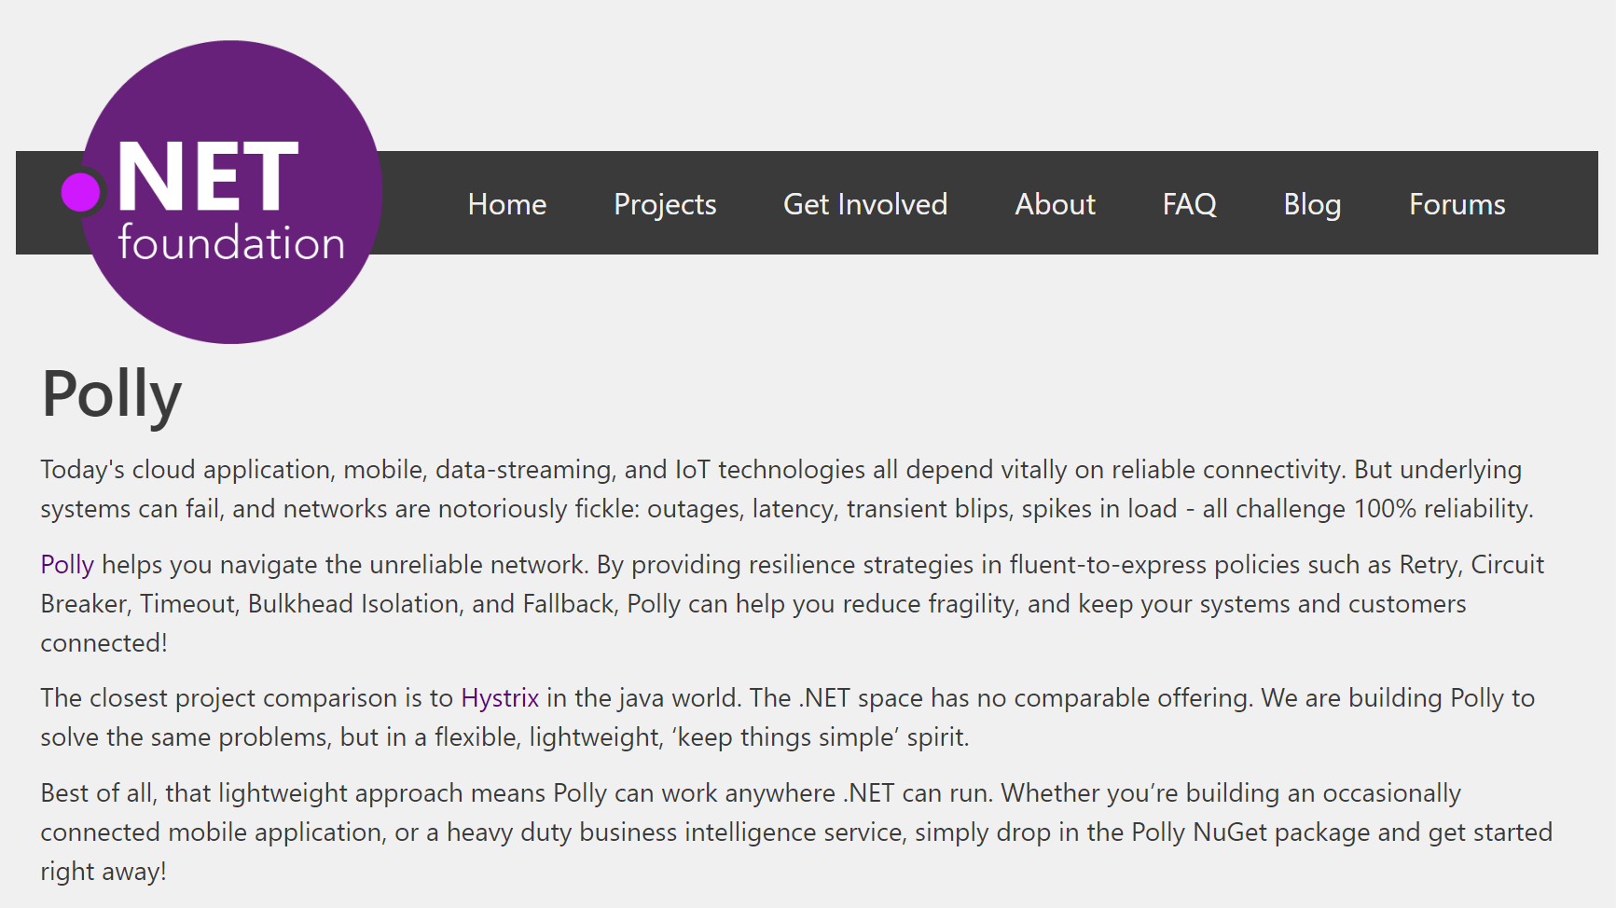
Notes:
Polly was accepted into the .NET Foundation in October, 2016!!

Slide 4
Transient Errors
Network outages
Service outages
Denial of Service attacks
IO locks
Connected device failures

Slide 5
What happens when you flood a struggling service with requests?

Slide 6

Notes:
Ladies throwing chocolates over their shoulders / into mouths = downstream system can’t cope, *dropping requests*

Slide 7

Polly to the rescue!
.NET 4.0 / 4.5+ / .NET Standard 1.1+ / .NET Core
Fluently express transient exception handling policies:
Retry, Circuit Breaker, Timeout,
Bulkhead Isolation, Fallback
https://github.com/App-vNext/Polly
Nuget: Install-Package Polly

Slide 8
Polly offers multiple resilience strategies ...
Retry … ‘Maybe it’s just a blip’
Circuit Breaker … ‘That system is down / struggling’
Timeout … ‘Don’t wait forever!’
Bulkhead isolation … ‘One fault shouldn’t sink the whole ship’
Cache … ‘You’ve asked that one before!’
Fallback … ‘If all else fails … degrade gracefully’
All policies can be combined, for multiple protection!

Slide 9
History of Polly
2013 Michael Wolfenden invents Polly 2015 Scott Hanselman (Microsoft) recommends Polly! Thoughtworks (Martin Fowler et al) recommend Polly!
Dec 2015 App-vNext take stewardship. Full async support. Apr 2016 Advanced circuit breaker. Circuit health reporting. Jul 2016 Handle return values as faults. .NET Core/Standard. Oct 2016 Timeout, Bulkhead Isolation, Fallback, PolicyWrap 2017 Cache, PolicyRegistry, InnerExceptions, RetryAfter, Jitter
2018 Integration in ASP.NET Core 2.1, within HttpClientFactory
Notes:
RetryAfter: Honors servers which return 429 status codes (“Retry-After: x milliseconds”), when servers rate-limit consumers.
Jitter: adds some randomisation to retry intervals, so that the retries themselves don’t become spikes in load.

Slide 10
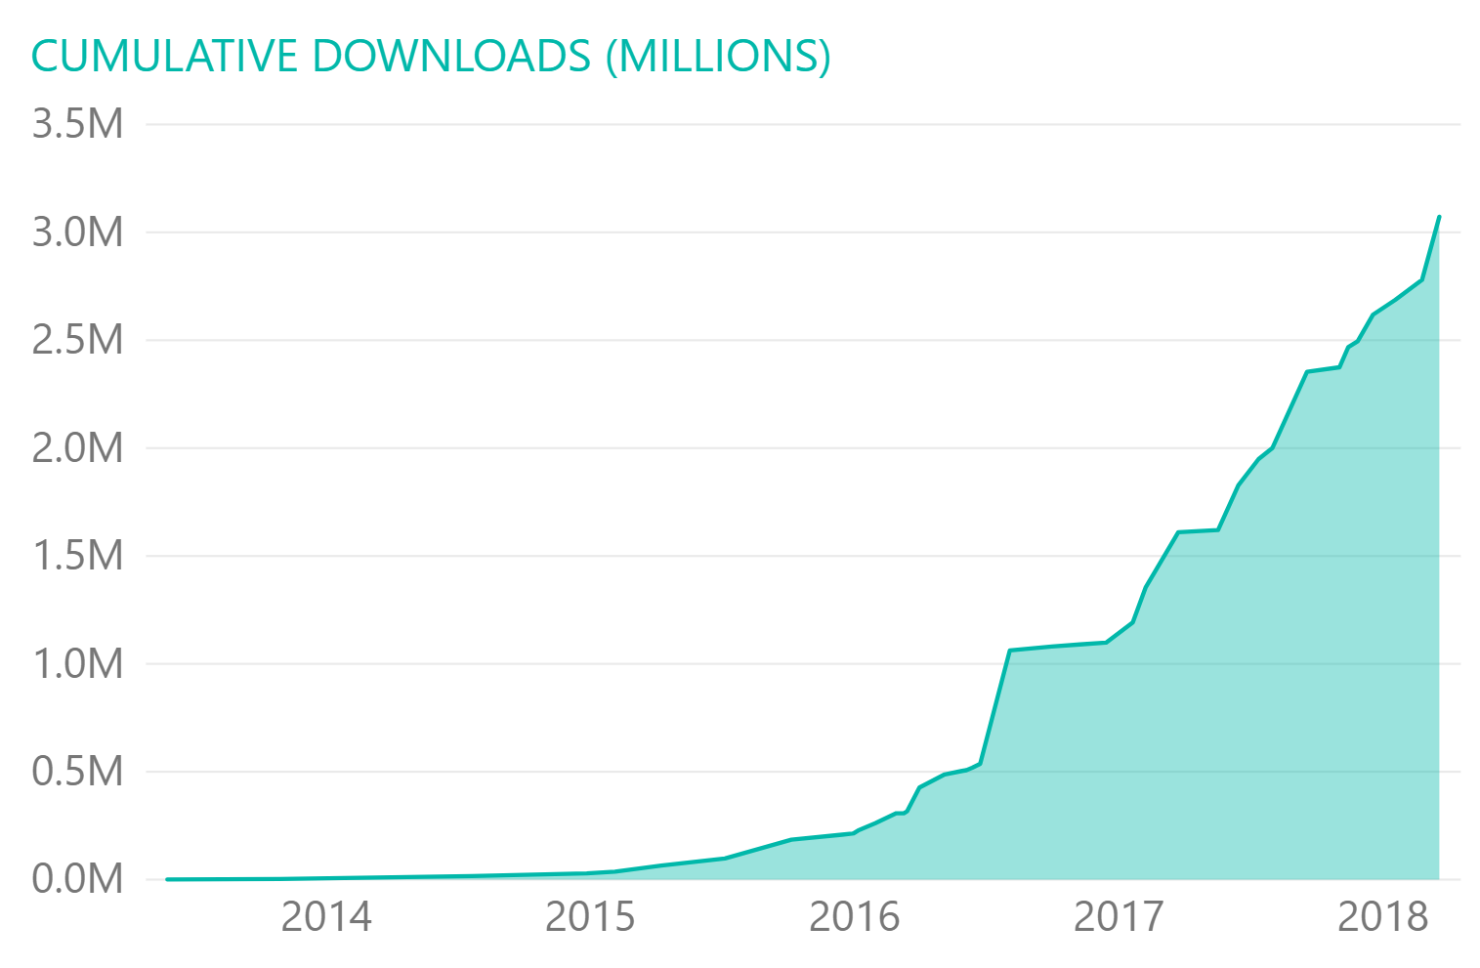
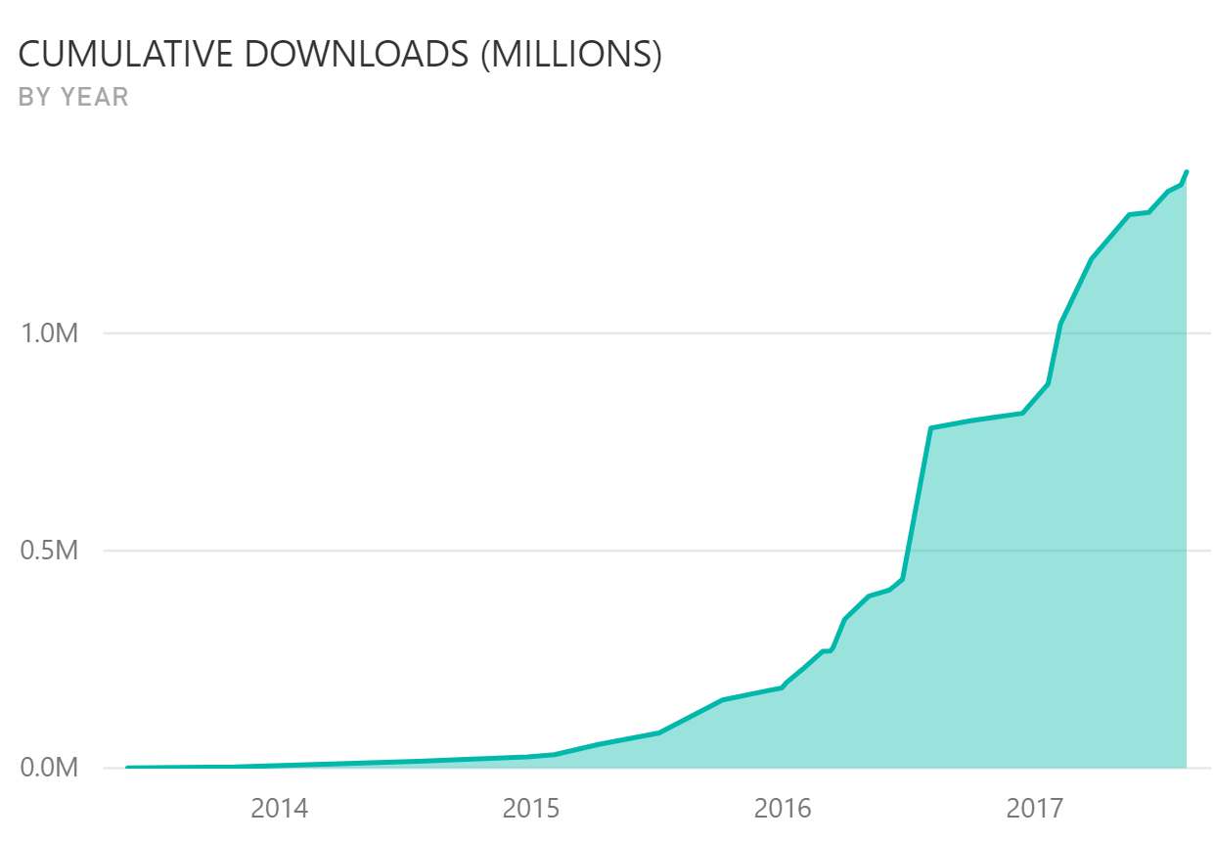
Polly ADOPTION
Polly main package downloads since May, 2013
Cumulative for all Polly packages to date: >3 million
40 releases, 32 since AvN took over in late 2015
Notes:
Currently running at around 10,000 downloads per day from Nuget

Slide 11
Step 1: Define Policy
var retryPolicy = Policy
.Handle<EndpointNotFoundException>()
.RetryForeverAsync();

Slide 12
Step 2: Execute with Policy
var response =
await retryPolicy.ExecuteAsync(() => DoSomething());

Slide 13
Retry Patterns
Retry immediately on failure. Specify number of retries.
Wait and Retry Retry with a timeout in between each try. Change the timeout between each retry, eg exponential back-off, jitter.
Retry Forever Keep retrying until succeeds.
Retry addresses ... ‘It’s probably a blip. Give it another go - it might succeed.’

Slide 14
Circuit Breaker
Circuit Breaker Breaks the circuit for a configured period if too many errors occur
Blocks calls while circuit is broken.
Protects downstream system - chance to recover.
Fail fast to the caller.
Circuit Breaker addresses … ‘Whoa, that system is struggling / down. Give it a break. And don’t hang around waiting for an answer that’s unlikely right now!’
Notes:
Circuit-Breaker: = The ladies in the video (= downstream system) are having a meltdown: so give them a break.
Stop sending chocolates down the line for a while, so they can recover (and if the calls/chocolates are only going to be dropped anyway, why send ‘em? Fail fast instead - don’t try calls which are unlikely to succeed!)
So: Fail fast = better user experience, if the call is likely to fail anyway.
*Original Circuit-Breaker*, trigger to break = too many chocolates in a row get dropped.
*Advanced Circuit-Breaker*, trigger to break = too high proportion of chocolates get dropped.

Slide 15
Timeout
Timeout Stop waiting once you think an answer will not come
Optimistic mode Co-operative timeout via CancellationToken
Pessimistic mode Enforces timeout (returns to caller) even when governed delegate doesn’t support timeouts/cancellation. Timeout ensures … calls can ‘walk away’ from a faulting downstream system, release blocked threads/connections etc.

Slide 16
Bulkhead Isolation
Bulkhead Prevents one operation from consuming more than its fair share of resources.
Imagine one stream of calls starts faulting slowly...
All threads in a caller could end up waiting on that system … until it starves the caller doing anything else.
Bulkhead prevents this, by limiting the resources (threads) used by separate call streams.
Bulkhead … ‘One fault shouldn’t sink the whole ship!’
Notes:
Source of bulkhead idea: Large ocean vessels are divided (inside the hull) into separate bulkheads. These can be sealed off (from one another). Idea: if ship damaged, only one bulkhead floods (each sealed off). One fault doesn’t sink the whole ship!
Related software principle: Limit the resources consumable by different operations, so that one faulting stream of calls can’t ‘sink’ the whole system.
Implementation = a simple parallelism throttle (SemaphoreSlim).
Usual : multiple bulkheads (of different capacities) for different call streams. Analogy: Supermarkets reserve separate groups of check-outs for “shopping carts” versus “baskets only” or “12 items or fewer”. Exactly bulkhead isolation. If they didn’t isolate different streams (if was all mixed), and there was a glut of large shopping carts going through, the large carts would flood all checkout aisles, use all capacity; this would prevent people with only small baskets also checking out quickly. By reserving some aisles for “baskets only”, those people with baskets can always checkout quick. Bulkhead isolation = separate defined capacity for different operations.
( Alternative identical analogy: airline check-in. There’s always a reserved check-in queue (reserved capacity) for first-class check-in. )
Analogy: think of those full shopping carts as slow-responding / heavy-payload / faulty endpoints on your service. Do you want those faulting calls to have the potential to gobble all resource, and also stop the other endpoints responding? Bulkhead isolation lets you avoid this – separate, sized channels for separate streams of calls.
Bulkhead also = pro-active load-shedder. Intentionally sheds load, when parallelism exceeded.
Why pro-actively shed load in advance of the server/service’s maximum capacity?
Because failing predictably (in a managed/controlled fashion) is better than failing in unpredictable or unexpected ways.
Analogy: humans drinking. Not having pro-active load management is like someone saying they know when they’ve drunk too much because they pass out or start behaving chaotically. Do you want to leave your servers unbounded, to “drink so many requests” that they start behaving chaotically or keel over? No? So: think about pro-active load-shedding.
Best: monitor bulkhead capacity; use full/near-full bulkhead as trigger for horizontal scaling.

Slide 17
Read-through Cache
Cache A certain proportion of calls will be duplicates. Serve from cache if you can - reduce latency and save calls.
Pluggable interface – simple to add any cache provider you like
Eg MemoryCache, Redis, Azure, Amazon ElastiCache, etc
Extension point for serialization/deserialization
Cache addresses … ‘You’ve asked that one before!’

Slide 18
Fallback
Fallback Specifies a substitute value to provide (or action to run) when an operation still fails.
Fallback addresses … ‘Failures will occur … prepare how you will respond when that happens’

Slide 19
Policy Wrap
PolicyWrap Combine any of the previous strategies into one concise policy.
PolicyWrap myResilience =
Policy.Wrap(fallback, retry, breaker, timeout);
myResilience.Execute(() => DoSomething());

Slide 20
Policy Basics
Define how transient exceptions should be handled
Fluent and concise
Thread-safe
Reusable across call sites
Sync and async
Chain policies together
Apply to any Action or Func (service calls, data stores, web requests, mobile connectivity)
Notes:
All these resilience patterns are brilliantly covered in Michael Nygard’s book Release It!

Slide 21
Demos
https://github.com/App-vNext/Polly-Samples

Slide 22
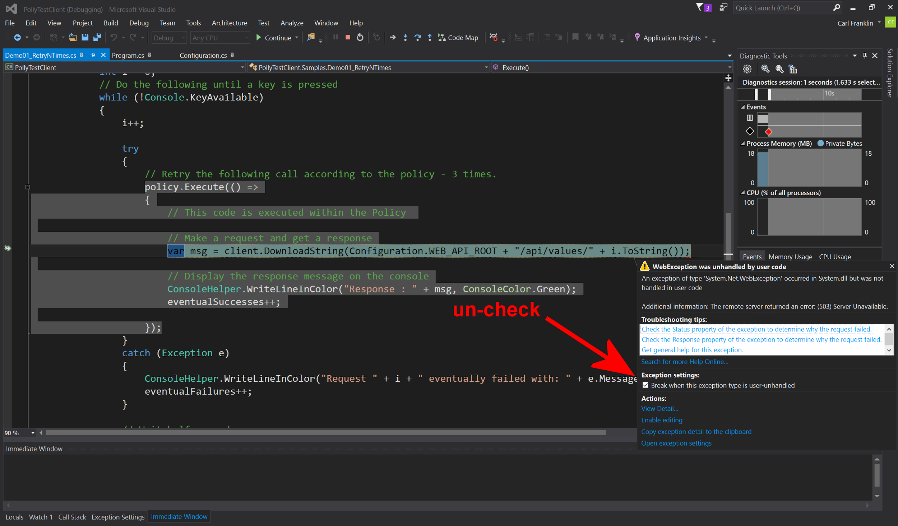
Notes:
Uncheck this tickbox if demoing the Samples out of Visual Studio simply by pressing F5 for Debug. Or ctrl-F5 for start-without-debug.

Slide 23
Further features
Handle multiple exception types in one policy; filter exceptions handled:
var policy = Policy .Handle<SqlException>(ex => ex.Number == 1205) .Or<TimeoutException>() .RetryAsync(3);
Register delegates (onRetry, onBreak etc) to capture policy events, eg for logging.

Slide 24
Further features
Handle both exceptions and return values within the same policy.
Ideal for HttpClient:
var httpPolicy = Policy .Handle<HttpRequestException>() .OrResult<HttpResponseMessage>(r => r.StatusCode == HttpStatusCode.InternalServerError) .RetryAsync(3);

Slide 25
Further features
Handle inner exceptions natively.
Useful where root cause exceptions can get wrapped in AggregateException:
var httpPolicy = Policy .Handle<HttpRequestException>() .OrInner<OperationCanceledException>() .RetryAsync(3);

Slide 26
Further features
PolicyRegistry: simple key-value store.
+ separate policy config (eg at startup) from usage
+ promotes DI: inject the registry to controllers, services
+ dynamically update policies in the registry, for dynamic reconfiguration during running. Tweak timeouts, circuit-breaker sensitivity etc in production.
Notes:
Bullet 3 – Dynamic Reconfiguration:
In some applications, it can be useful to be able to reconfigure policies dynamically without restarting the process.
Eg You might want to tweak circuit-breaking thresholds to be more or less sensitive according to conditions in production.
With PolicyRegistry, you can simply replace the policy in the registry with a new one, when the underlying configuration source is detected to have changed.
This allows updating the policy-to-use without the thread-safety / mutability concerns that updating an actually in-use policy instance would have.
More at: https://github.com/App-vNext/Polly/wiki/Dynamic-reconfiguration-during-running

Slide 27
2018 roadmap?
Telemetry Emit eg circuit health, call duration to dashboards, for real-time monitoring
ASP.NET Core 2.1 integration Polly will be integrated into HttpClientFactory in ASP.NET Core.
+ Fluent syntax for configuring HttpClient instances with Polly policies governing calls
+ HttpClientFactory also manages HttpClient lifetimes
https://github.com/aspnet/HttpClientFactory/
Notes:
Notes on HttpClientFactory: (beyond Polly)
Part of upcoming ASP.NET Core 2.1
Fluent syntax for configuring HttpClient instances with Polly policies governing calls
Provides a central location for naming and configuring logical HttpClients. For example, you may configure a client that is pre-configured to access the github API.
Manages the lifecycle of HttpClient instances – deals with earlier confusion about how frequently to recycle/dispose HttpClient instances, for performance and to capture DNS changes
If users have questions about HttpClientFactory, point them to Glenn Condron’s blog post : https://blogs.msdn.microsoft.com/webdev/2018/02/28/asp-net-core-2-1-preview1-introducing-httpclient-factory/
Or Steve Gordon’s blogs: https://www.stevejgordon.co.uk/introduction-to-httpclientfactory-aspnetcore

Slide 28
Polly Wiki
Future Roadmap
Extended documentation
Configuration recommendations
Patterns
Unit-testing strategies
https://github.com/App-vNext/Polly/wiki

Slide 29
Polly Slack channel and Blog
http://www.pollytalk.org/ (slack)
Ask questions
Discuss the roadmap
http://www.thepollyproject.org/ (blog)
Project updates, the inside track

Slide 30
App vNext Polly team
Carl Franklin .NET Rocks, Music to Code By
Joel Hulen Enterprise software and cloud architect
Dylan Reisenberger .NET enterprise architect, special interest in microservices, messaging, cloud, resilience.
… and all you folks who want to make open-source contributions …
https://github.com/App-vNext/Polly/

Slide 31
THANK YOU!
Notes:
Abstract:
Connected applications only work when connected. What happens if the network breaks temporarily? Will your system recover smoothly or pitch a fit? Using an OSS project called Polly (available on GitHub) you can handle this and many other transient situations with elegance and fluency. Polly let’s you define resilience and load-handling policies such as retry, wait and retry, circuit breaker, bulkhead isolation and timeouts and more. Learn how to make your system bulletproof with Polly and a little know-how.

